Slide 1
Network Security And Forensics
(Protecting computers connected through the Internet)

Slide 2
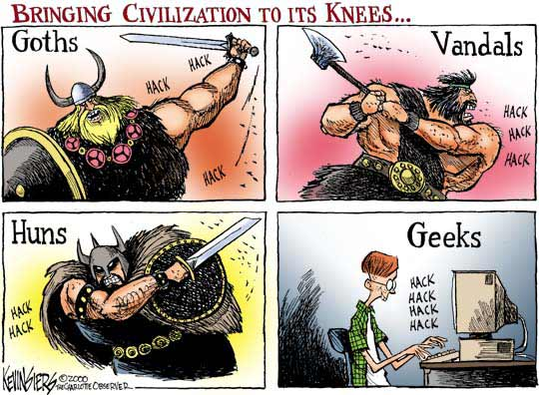
A Brief History of the World

Slide 3
Hacking
(internal or external)
Organized Crime
Tools available for anyone (marketplaces)
Organized markets for the stolen goods
System kidnapping
Botnet networks for lease
Hacking for hire
Bitcoin for payments

Slide 4
And it need not be hacking alone...

Slide 5
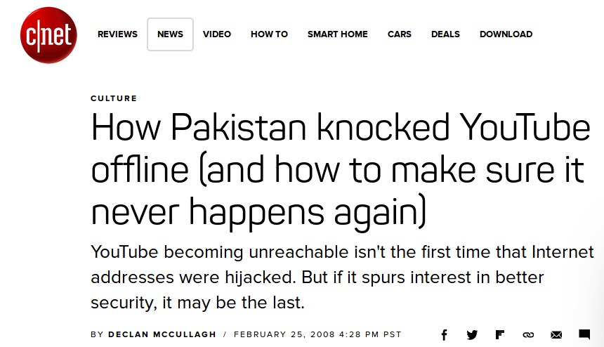

Slide 6
All Data Holders are Targets
Wherever valuable data can be found
  Creative uses of data (blackmail)
  Data is power
Wikileaks
Monitoring of phone calls
  VoIP
Some tools difficult to hack
  Whatsapp

Slide 7
Take Away
Anybody can be a hacker now
  Juvenile laws etc. etc..
Anybody can profit from hacking now
Any data holder can be hacked
Your HAVE been hacked, ARE BEING hacked, and WILL be hacked

Slide 8
International Problem
Cross Jurisdictional Crimes
  Data breach in India from Pakistan !!
Multi-lateral Enforcement
Contracting for Cloud Safety
  What if data stored in the cloud is breached?
Cross-Border Data Transfers
  Internet routers do not use shortest path and are not stored or registered

Slide 9
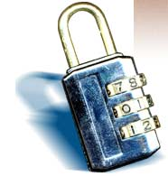
Overview
What is Network security?
Common security attacks and countermeasures
  Firewalls & Intrusion Detection Systems
  Denial of Service Attacks
  TCP Attacks
  Packet Sniffing
  Social Problem
Network Forensics
Some Takeaway

Slide 10
Common security attacks and their countermeasures
Finding a way into the network
  Firewalls
Exploiting software bugs, buffer overflows
  Intrusion Detection Systems
Denial of Service
  Ingress filtering, IDS
TCP hijacking
  IPSec
Packet sniffing
  Encryption (SSH, SSL, HTTPS)
Social problems
  Education

Slide 11

Firewalls
Basic problem – many network applications and protocols have security problems that are fixed over time
  Difficult for users to keep up with changes and keep host secure
  Solution
    Administrators limit access to end hosts by using a firewall
    Firewall is kept up-to-date by administrators
A firewall is like a castle with a drawbridge
Can be hardware or software

Slide 12
Firewalls
Internet
DMZ
Web server, email server, web proxy, etc
Firewall
Firewall
Intranet

Slide 13

Intrusion Detection
Used to monitor for “suspicious activity” on a network
  Can protect against known software exploits, like buffer overflows
  Uses “intrusion signatures”
  Well known patterns of behavior
    Ping sweeps, port scanning, web server indexing, OS fingerprinting, DoS attempts, etc
IDS is only useful if contingency plans are in place to curb attacks as they are occurring

Slide 14

Denial of Service
Purpose: Make a network service unusable, usually by overloading the server or network
Many different kinds of DoS attacks
  SYN flooding
  SMURF
  Distributed attacks

Slide 15
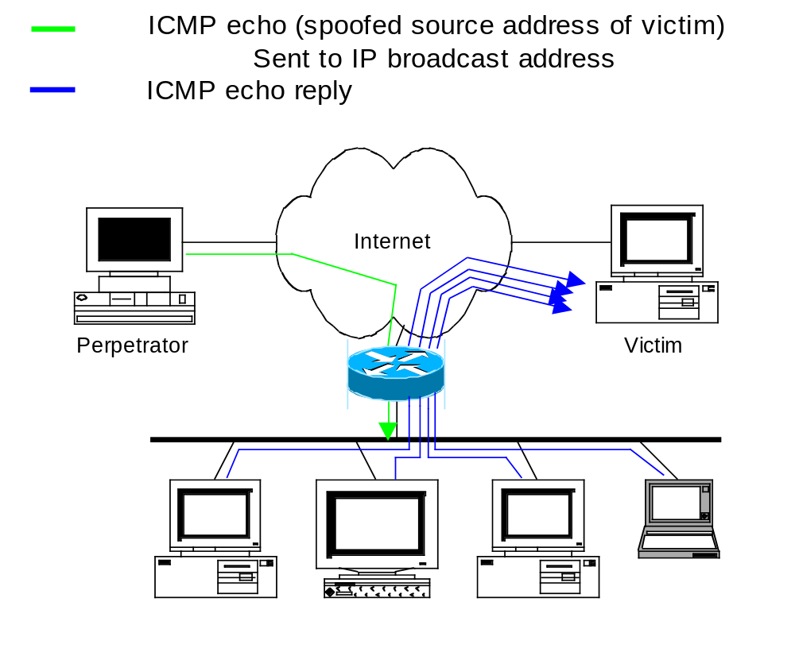
Denial of Service

Slide 16

TCP Attacks
TCP connections have associated state
  Starting sequence numbers, port numbers
Problem – what if an attacker learns these values?
  Port numbers are sometimes well known to begin with (ex. HTTP uses port 80)
  Sequence numbers are sometimes chosen in very predictable ways

Slide 17
TCP Attacks
If an attacker learns the associated TCP state for the connection, then the connection can be hijacked!
Attacker can insert malicious data into the TCP stream, and the recipient will believe it came from the original source
  Ex. Instead of downloading and running new program, you download a virus and execute it

Slide 18



TCP Attacks
Why are these types of TCP attacks so dangerous?
Web server
Trusting web client
Malicious user
Notes:
Malicious user can send a virus to the trusting web client, instead of the program they thought they were downloading.

Slide 19
TCP Attacks
How do we prevent this?
IPSec
  Provides source authentication, so Mr. Big Ears cannot pretend to be Alice
  Encrypts data before transport, so Mr. Big Ears cannot talk to Bob without knowing what the session key is

Slide 20

Packet Sniffing
This works for wireless too!
In fact, it works for any broadcast-based medium
What kinds of data can we get?
  Asked another way, what kind of information would be most useful to a malicious user?
Answer: Anything in plain text
Passwords are the most popular

Slide 21

Social Problems
People can be just as dangerous as unprotected computer systems
  People can be lied to, manipulated, bribed, threatened, harmed, tortured, etc. to give up valuable information
  Most humans will breakdown once they are at the “harmed” stage, unless they have been specially trained
    Think government here…

Slide 22

What is network forensics
“Network forensics is a sub-branch of digital forensics relating to the monitoring and analysis of computer network traffic for the purposes of information gathering, legal evidence, or intrusion detection.”

Slide 23

Quick evidence review
Real evidence - physical objects that play a relevant role in the crime
  Physical HHD or USB, Computer – box, keyboard, etc.
Best evidence - can be produced in court
  Recovered file, Bit – for – bit snapshot of network transaction
Direct evidence – eye witness
Circumstantial evidence – linked with other evidence to draw conclusion
  Email signature, USB serial number
Business records – routinely generated documentation
  Contracts and employee policies, Logs
Digital evidence – electronic evidence
  Emails / IM, Logs

Slide 24
Dead-box vs. network forensics
Dead-box
Network
Data is static and preserved once power is removed
Evidence is contained within the file system
Easy to make a forensically sound image
Seizing a businesses computer/s usually involves limited disruption
Legal precedence in place and is routinely admitted into court
Data is changing constantly
Pinpointing direct location of needed evidence is problematic
Physical access to network devices can be difficult
Most network devices do not have persistent data storage
Investigators must minimize investigation impact on business network
Conflicting precedence and not yet standardized

Slide 25

Investigative methodology
OSCAR
  Obtain information
  Strategize
  Collect evidence
  Analyze
  Report

Slide 26

Obtain information
Incident description
Information regarding incident discovery
Known persons involved
Systems and / or data known to be involved
Actions taken by organization since discovery
Potential legal issues
Working time frame for investigation and resolution
Specific goals
Data sizes can be HUGE (peta bytes / sec)
(1000000000000000 * 8 bits per second) - Blue Ray Movie 3.7Gb

Slide 27
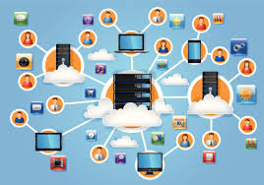
The Environment
Working business model and enforceable policies
Potential legal issues involved with said business model and policies
Organizational structure
Network topology
Possible network evidence sources
Incident response management procedures
Central communication systems (investigator communication and evidence repository)
Available resources
  Staff, Equipment, Funding, Time

Slide 28
Strategize
Identify and document evidence sources
Estimate value of evidence versus value of obtaining it
Prioritize based on this estimate
Plan of attack – both for acquisition and analysis
Remember that this is fluid methodology and will most likely have to be adjusted

Slide 29
Collect evidence
Document, document, document
Lawful Evidence Capture
Cryptographically verifiable copies
Secure storage of collected evidence
Established chain of custody
Analyze of copies only
Legally obtained, reputable tools used
Every step documented

Slide 30
Analyze
Correlation with multiple sources of evidence
Documented timeline of activities
Corroborate all evidence, which may require more evidence gathering
Build working theories that can be backed up by the evidence (this is only to ensure a thorough investigation)
  SEPARATE INTERPRETATIONS FROM THE FACTS

Slide 31
Works cited
http://en.wikipedia.org/wiki/Network_forensics#cite_ref-0
http://www.evidencemagazine.com/index.php?option=com_content&task=view&id=116&Itemid=49
Davidoff, S., & Ham, J. (2012). Network Forensics Tracking Hackers Through Cyberspace. Boston: Prentice Hall.

Slide 32
Take Away
What is Reasonable?
Appropriate budget for security was provided?
Appropriate training was provided?
Up to Date Knowledge on tools, standards, risks were known?
Local Risk management structure was established ?
Pre-planning for incidents done?
Security around obligations, risks and types of data available?

Slide 33
Internal Walls as Important as External
System level, Application level, Hardware level protection
Cyber insurance
Hedging of Risks?
Reasoning and actions documented?
Check Third party advice why the decisions were reasonable

Slide 34
Case Study:
Things Target Did Wrong
System Issues:
  Upgraded POS systems without security audit
  Did not listen to its own network warnings
  Needed more compartmentalized network
Personnel Issues:
  No CISO or single name for data security
  CTO/CIO had no technical background

Slide 35
Things Target Did Well
Its Website is helpful, informative and complete
Apologize
“Hold Harmless” promise to customers
Help line
Invested in Cyber Security Education

Slide 36
The Role of Vendors
The vendor may be a trap door
The vendor may lose your data
Require: protection, notice, insurance, audit, indemnity, high liability cap
Review: procedures, personnel, technology, training

Slide 37

Conclusions
The Internet works only because we implicitly trust one another – Security WAS NOT a design parameter
It is very easy to exploit this trust – Eg. Facebook
The same holds true for software
Latest Cyber Emergency Response Teams security advisories to know how to patch any security holes
Correlation, Documentation and preservation very important

